Slide 1
CAMPAIGN FUNDRAISING
Notes:
For a variety of reasons, Wyoming is a unique place to raise money for a campaign.
And I do want to give a disclaimer that depending on if you are running for a local, state or federal office – your fundraising opportunities and challenges will be different.

Slide 2
WHY IT’S IMPORTANT
Campaigns are expensive
Direct mail pieces + radio, TV and digital MOVE NUMBERS!
Build a war chest
Money
Public supporters
Volunteers
Social media + email addresses
Notes:
It takes 7 hits to sink a message. And achieving those 7 hits without paid media or digital

Slide 3
WHY IT’S TOUGH SOMETIMES … but what to remember!
Asking for money is tough.
And you have to ASK, ASK, ASK … and ASK again!
Donors are used to being asked.
Small to big donations = Buy-in from voters & potential volunteers!
People want to help!

Slide 4
GET ORGANIZED
Develop a Campaign Budget
Campaign Fundraising Plan + Calendar (events, goals, reporting deadlines, etc.)
Set-up a Finance Committee
Lists, lists, lists
Friends, Family & Neighbors
Community & Business Leaders
Previous donors to yours and other races
Cultivating relationships with potential donors
Develop & practice your ask!
Look for opportunities to customize your ask to your audience
Fundraising Materials – Make it as Easy As Possible for Donors!
Fundraising form
Online option
Return envelope

Slide 5
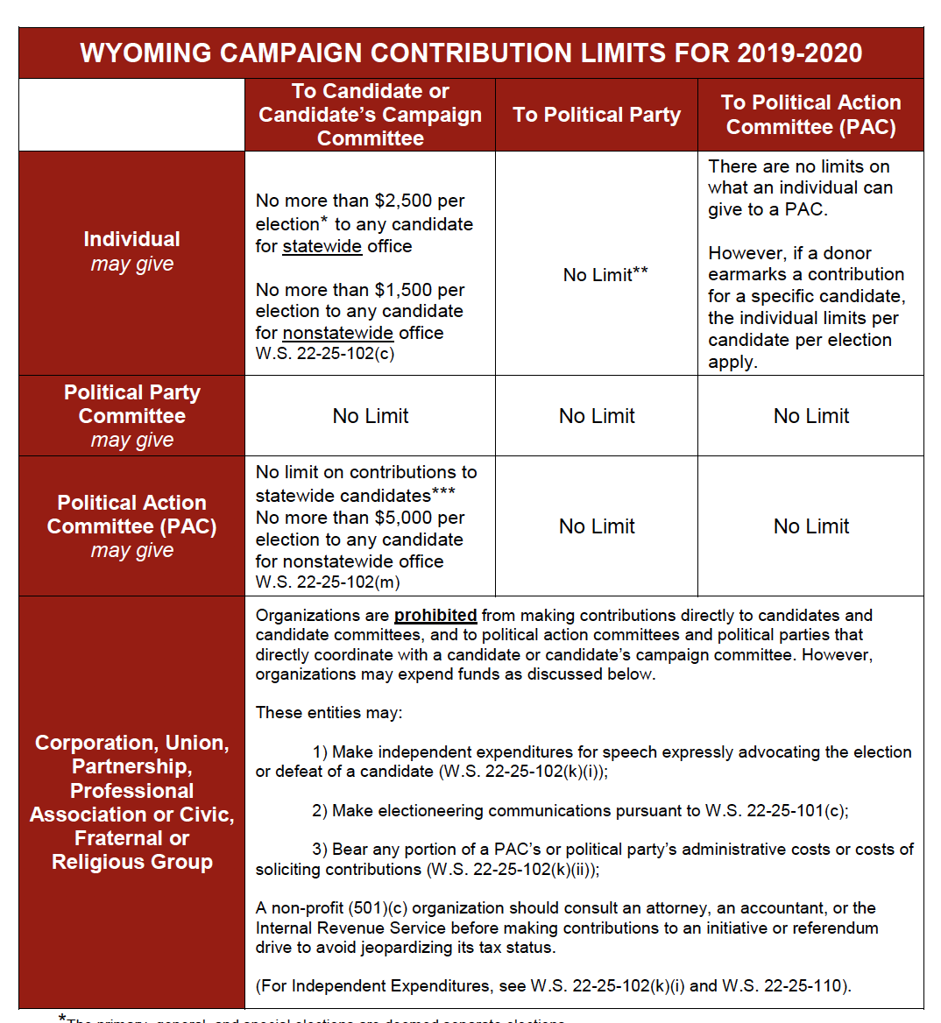
KNOW THE RULES
Resources from Wyoming Secretary of State’s Office (page 9)
https://sos.wyo.gov/Elections/Docs/2020/2020_Campaign_Guide.pdf
NOTE, 2022 guide will be available after the 2022 legislative session.

Slide 6
FAMILY, FRIENDS & NEIGHBORS
Start with low-hanging fruit: Family, Friends & Neighbors
Sit down & make a list
Send a letter or email
Dear Name
Ask for a specific amount
Add a short, personal note to printed letter
Include a return envelope with a stamp
Follow up two weeks after mail drops with phone call
… But what if my network has limited resources??

Slide 7
FUNDRAISING THROUGH THE MAIL
Build a list
Source from other candidates
Local parties
Comb through FEC reports
List rentals
Statewide races
Content
Bold key points
Break up paragraphs into short graphs
Be specific about your vision & what you want to accomplish
Ask for a specific amount
Include where to send donations & if donating online is an option
Create urgency (fundraising deadline, # days until election, day after debate, etc.)

Slide 8
EVENTS
Ask family & friends to host small & big dollar donor events
Host Committees
Hosts commit to raising or donating a certain amount of money
Aim for donated space, food and beverage – keep overhead low!
Signature Campaign Events
Ice cream socials
Equalitea
Picnics in the Park
Square reader or device to accept credit card donation
Donation envelopes available

Slide 9
DIGITAL FUNDRAISING
DONATE Button on the top of the website!
And on EVERY digital communication you send + Email Signature
Online Donation Platform
PayPal, Square, Anedot, ActBlue, WinRed, RallyPay, etc.
Option for recurring donations
Include limits and disclaimers
Social Media
Surveys & Petitions
Facebook Events
Create urgency (fundraising deadline, # days until election, day after debate, etc.)
Zoom Fundraisers/Roundtables

Slide 10
FOLLOW UP & THANK YOU’S
Follow-up letters with phone calls
Follow-up with primary election donors for general election donation
Thank You’s for all donations & event hosts
Continue non-fundraising communications & outreach
Cultivating donors never stops!

Slide 11
LEAVE NO STONE UNTURNED
Dialing for dollars/Call Time
Connecting with organizations & industries you support
Groups supporting candidates, like Cowgirl Fund Run
Ask friends & supporters to introduce you to potential donors
MAKE THE ASK!

Slide 12
QUESTIONS?

